Slide 1
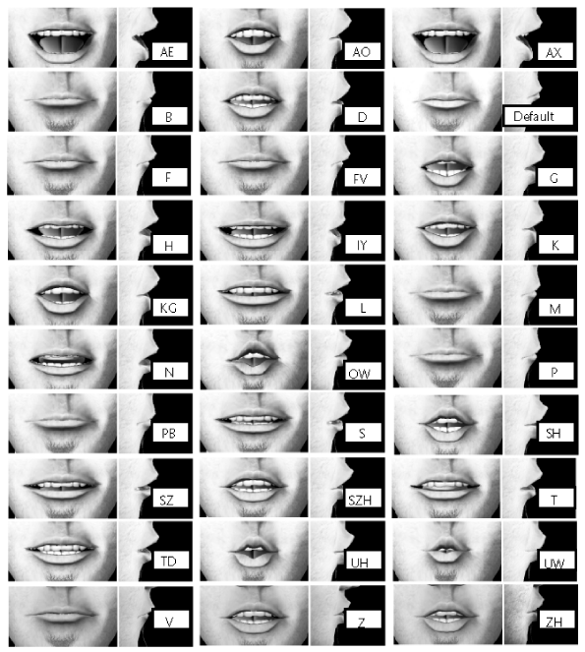
1 | 2 | 3 | 4 | 5 | 6
7 | 8 | 9 | 10 | 11 | 12
13 | 14
TH

